Slide 1
Marketing mix modelling
LBE Insights & Analytics
Data Science & Insights Team

Slide 2
Opening scene: the agenda
Budget Planning
  Budget Scenario Analysis
  TRR and PDM Budget Summary
LOB Overview
  LBE Performance Review
  LBE Media Spend vs Transaction Analysis
  New Location Analysis
  Flighting and Insights
Channel Planning
  Channel – specific performance review
This iteration of MMM accounts for data Q2 2023 to Q2 2025

Slide 3
Summary OF OUTPUTS

Slide 4
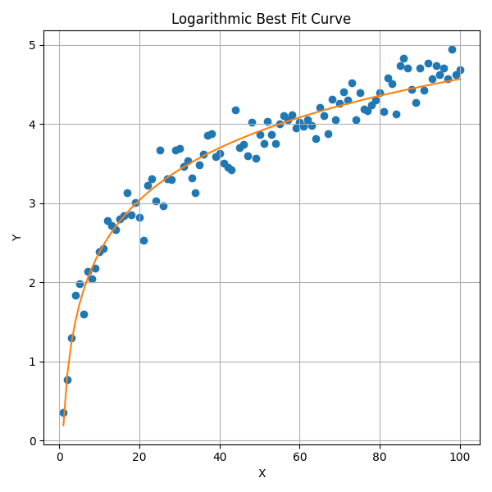
Scenario analysis methodology
Approach
The model analyzes the last 52 weeks of campaign spend and corresponding LBE transactions to simulate a budget curve. Each week’s spend is mapped to its contribution, with thousands of simulations generating a best-fit curve.
Methodology
Simulations assume a realistic spend ceiling based on domain knowledge to estimate where marginal returns begin to diminish significantly.
Output
The resulting budget curve illustrates expected returns at different spend levels, with Marginal ROI calculated as the slope at each point along the curve.
Variables
Weekly media spend is used as the predictor, and weekly campaign contributions to LBE transactions are the predicted variable
(Above is an example and does not represent actual data)

Slide 5
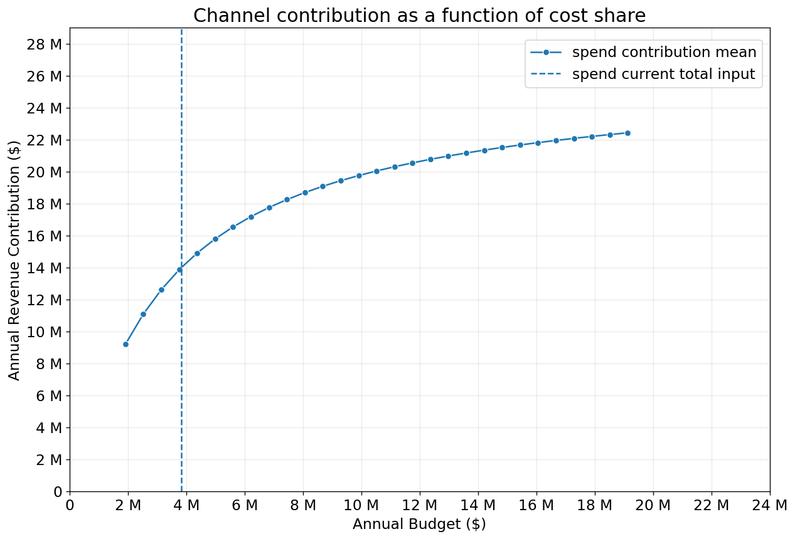
BUDGET SCENARIO analysis
Current Spend (~$3.8M) is in the Steep-Growth Zone. Implying solid returns on each additional dollar spent.
The curve continues to rise steadily beyond the current spend, indicating room for growth.
Increasing budget modestly (e.g. $1M-$2M more) would likely still generate strong incremental revenue.
Increasing the budget from around $4M to $6M would result in $3M additional revenue contribution.
Returns on additional spend diminish as the budget increases. At one point, the budget would have to increase by $4M to receive $1M in revenue contribution.
2025
* Budgets have been scaled up to account for missing/incomplete data
Notes:
Somewhere beyond ~$12M–$14M, the curve starts to flatten significantly.
This means there is an optimal budget range beyond which further investment may not justify the cost unless strategic goals change (e.g., market dominance).

Slide 6

BUDGET SCENARIO analysis
2025
2024
* Budgets have been scaled up to account for missing/incomplete data
Notes:
Somewhere beyond ~$12M–$14M, the curve starts to flatten significantly.
This means there is an optimal budget range beyond which further investment may not justify the cost unless strategic goals change (e.g., market dominance).

Slide 7
BUDGET SCENARIO analysis
 | Business As Usual (Last 12 months) | $136M Revenue (BAU) | $140M Revenue (3% higher) | $145M Revenue (7% higher)
Budget (ex-PR) | $3.6M | $3.6M | $6.8M | $16.8M
Budget | $3.8M | $3.8M | $7.0M | $17.0M
LBE Revenue Contribution | $14.0M | $14.0M | $18.0M | $22.0M
LBE Profit Contribution | $9.1M | $9.1M | $11.7M | $14.3M
Marginal Revenue ROI | 2.0 | 2.0 | 0.8 | 0.3
HPL | $0.8M | $2.1M | $3.9M | $9.7M
LPL | $1.3M | $0.6M | $1.2M | $2.9M
NL - TRR | $1.0M | $0.4M | $0.7M | $1.7M
NL - PDM | $0.2M | $0.1M | $0.2M | $0.4M
PDM | $0.3M | $0.4M | $0.7M | $1.9M
PR | $0.2M | $0.2M | $0.2M | $0.2M
This model evaluates budget allocation efficiency by analyzing marginal revenue ROI across increasing budget levels. It measures how much incremental revenue and profit are generated by distributing budgets across different location buckets.
Model suggests that current budget levels are delivering strong revenue and profit contribution at current levels.
Reweighted budget would include a higher proportion of spend in HPL campaigns.
Link to worksheet
* Spend for NL - TRR has been recalculated, since data spans 2 quarters
* Budgets have been scaled up to account for missing/incomplete data
Notes:
Model aims to maximize profit contribution by identifying the most efficient allocation of budget across location buckets, prioritizing those with higher incremental ROI.

Slide 8
The Rec room BUDGET SUMMARY
HPL = High-performing locations
LPL = Low-performing locations
NL = New locations
TRR = The Rec Room
2026 TRR Budget Input |  | $3,743,000 |  | 2-Year Actual Past Budget |  | $5,600,000
 |  |  |  | Weeks |  | 52
Location Bucket | Contribution to Revenue (all factors) | Contribution to Revenue (internal factors only) | Spend Proportion (trailing 2 years) | Actual Yearly Spend (trailing 2-year avg.) | Model-based 2026 Allocation | Model-based 2026 Allocation / week
HPL | 3.4% | 68.0% | 26.6% | $753,680 | $2,545,240 | $48,947
LPL | 1.0% | 20.0% | 41.8% | $1,182,230 | $748,600 | $14,396
NL - TRR | 0.6% | 12.0% | 31.6% | $893,190 | $449,160 | $8,638
Total | 5.0% | 100.0% | 100.0% | $2,829,100 | $3,743,000 | $71,981
The model reallocates the 2026 budget based on each location bucket’s contribution to revenue (i.e., revenue attributable to controllable marketing factors).
While HPL locations showed the highest efficiency in transaction-driven returns, sustained investment is still necessary in LPL and NL to support long-term brand awareness and market presence in these regions.
HPL campaigns had the lowest average spend at around 27% over the past two years, yet it contributed to 68% of revenue, indicating high campaign efficiency.
Note:
“All factors” includes seasonality, holidays, and weather. Excluding these leads to normalization of contribution using only factors within control (internal factors).
Link to worksheet
* Spend for NL - TRR has been recalculated, since data spans 2 quarters
* Budgets have been scaled up to account for missing/incomplete data
Notes:
Past spend proportions were compared to transaction contribution shares, and the 2026 allocation was optimized to better align investment with true performance impact

Slide 9
Playdium BUDGET SUMMARY
HPL = High-performing locations
LPL = Low-performing locations
NL = New locations
PDM = Playdium
2026 PDM Budget Input |  | $636,000 |  | 2-Year Actual Past Budget |  | $900,000
 |  |  |  | Weeks |  | 52
Location Bucket | Contribution to Revenue (all factors) | Contribution to Revenue (internal factors only) | Spend Proportion (trailing 2 years) | Actual Yearly Spend (trailing 2-year avg.) | Model-based 2026 Allocation | Model-based 2026 Allocation / week
NL - PDM | 0.5% | 19.2% | 43.9% | $192,879 | $122,308 | $2,352
PDM | 2.1% | 80.8% | 56.1% | $246,586 | $513,692 | $9,879
Total | 2.6% | 100.0% | 100.0% | $439,465 | $636,000 | $12,231
Established Playdium locations have higher contribution to revenue, and thus higher efficiency in spend.
New location spending accounted for around 44% of the budget on average but only contributed to 19% of revenue.
Note:
“All factors” includes seasonality, holidays, and weather. Excluding these leads to normalization of contribution using only factors within control (internal factors).
Link to worksheet
* Spend for NL - TRR has been recalculated, since data spans 2 quarters
* Budgets have been scaled up to account for missing/incomplete data

Slide 10
Budget key takeaways
Maintain the core spend:
  Current budget is generating strong returns.
Incrementally increase budget:
  Modest increases can unlock more growth.
Monitor for diminishing returns beyond ~$12M:
  Apply scrutiny to any spend above this level.
Use ROI modeling to guide scaling decisions:
  There's no clear plateau yet.
Sustain high-performing locations:
  These scale well and sustain ROI as spend grows.
Low Performing and New Locations:
  While the model suggests to keep fixed or reduce budgets. Paid media will still need increased investment to achieve reach and build awareness.

Slide 11
Lines of business

Slide 12
lob summary

Slide 13
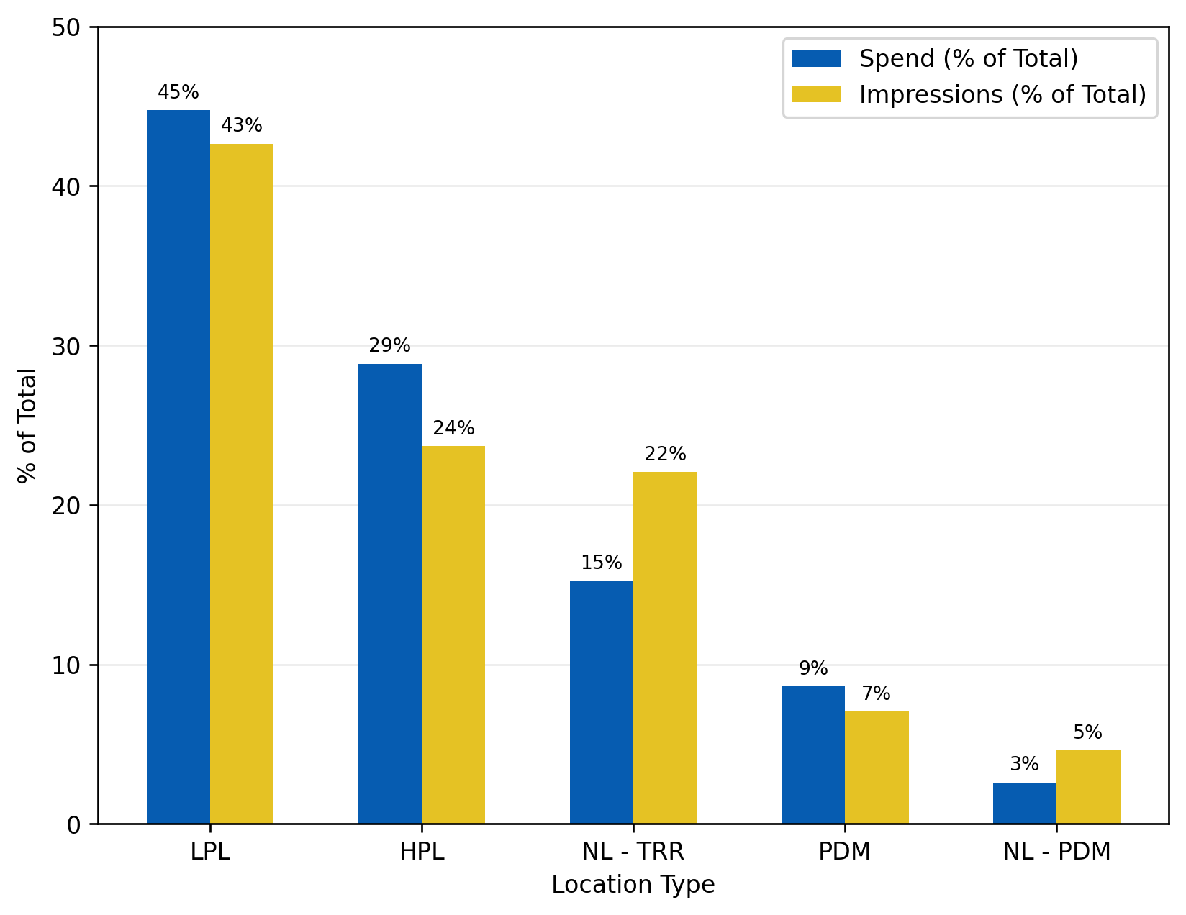
LBE Spend by location type vs impressions
HPL = High-performing locations
LPL = Low-performing locations
NL = New locations
TRR = The Rec Room
PDM = Playdium
Rec Room New Location campaigns accounted for 15% of the budget but brought in 22% of all impressions, indicating efficiency in the location bucket.
Playdium New Location was another location type that had high efficiency campaigns for awareness.
Note:
“NL - TRR” includes:
  Vancouver Granville
  Montreal Royalmount
“NL - PDM” includes:
  Toronto Fairview
*Data covers Q2 2023 to Q2 2025
*Data does not consider external factors such as weather, holidays
Awareness Campaigns

Slide 14
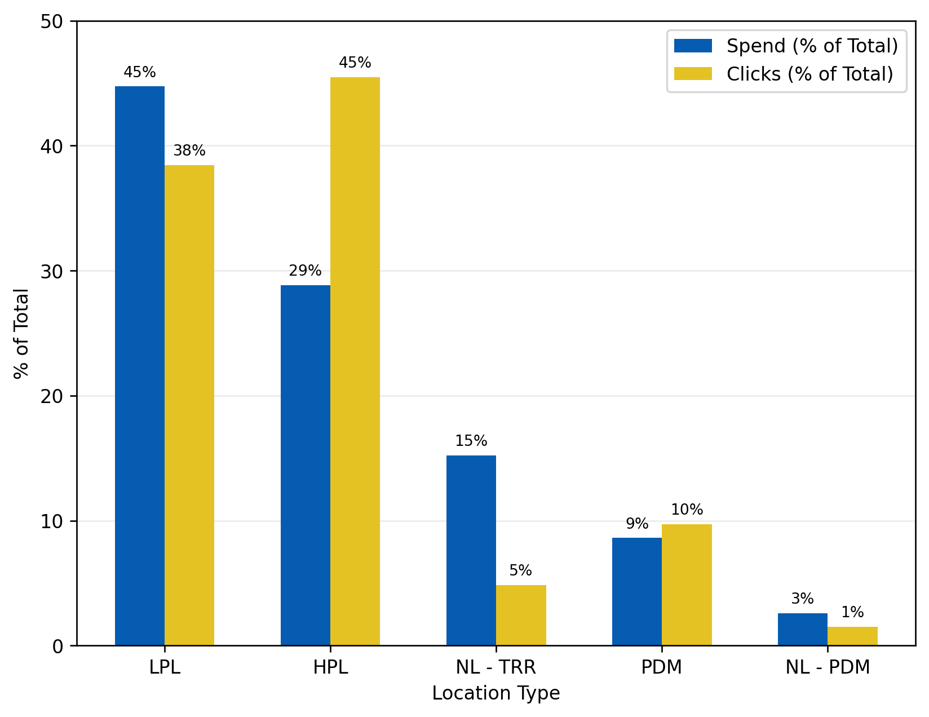
LBE Spend by location type vs clicks
HPL = High-performing locations
LPL = Low-performing locations
NL = New locations
TRR = The Rec Room
PDM = Playdium
High-Performing Location campaigns accounted for 29% of the budget but brought in 45% of all clicks, indicating high efficiency in the location bucket.
Neither Rec Room New Location nor Playdium New Location had efficient consideration campaigns compared to other location types.
Note:
“NL - TRR” includes:
  Vancouver Granville
  Montreal Royalmount
“NL - PDM” includes:
  Toronto Fairview
*Data covers Q2 2023 to Q2 2025
*Data does not consider external factors such as weather, holidays
Consideration Campaigns

Slide 15
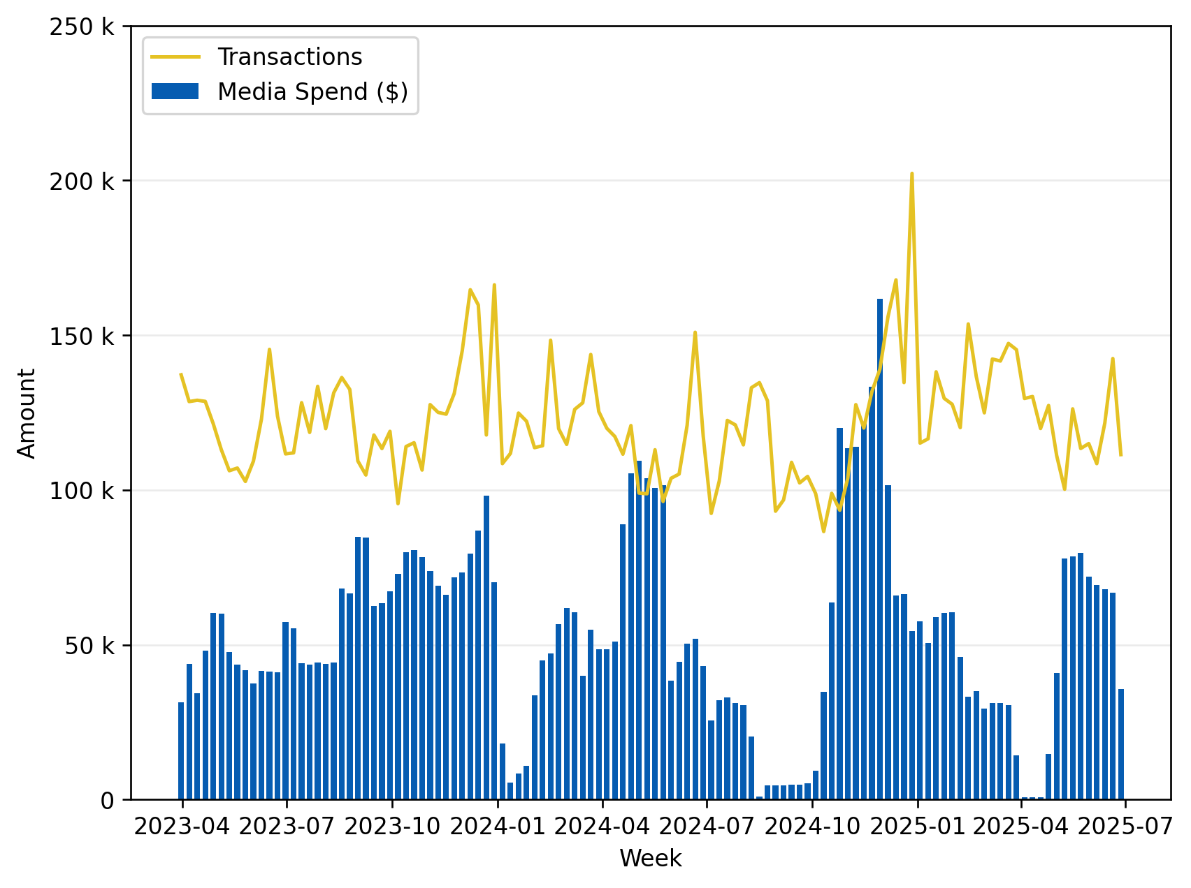
LBE spend by week vs Transactions
Transactions follow a decreasing trend with spend staying around the same after Q1 2024, indicating a decrease in ROAS.
Indicates diminishing returns or that media is less effective without supporting conditions.
Holiday season spend usually sees a large uptick in transactions in following weeks.
During low or no media spend windows (mid-2024, early 2025), transaction volumes tend to decline or become erratic. Reinforces the dependence on media for driving demand.
Note:
There is a moderate correlation between spend and transactions during Q2 and low correlation between the variables in Q1 and Q3.
*Data covers Q2 2023 to Q2 2025
*Data does not consider external factors such as weather, holidays
All Campaigns

Slide 16
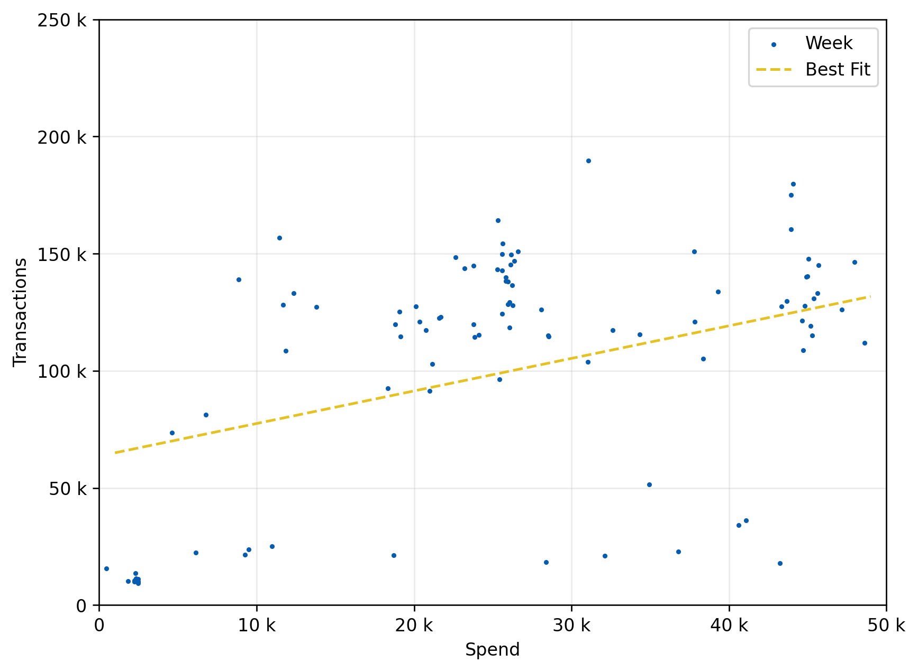
LBE Spend vs transactions
In general, higher spend translates to higher transactions.
Note:
Correlation of 0.47, moderate
Weeks in this region had New Location campaigns with delayed effects and so transactions are not reflected immediately. This weighs down the correlation figure.
Highlighted region displays weeks with high spend and relatively low transactions (Dec 2024).
*Data covers Q2 2023 to Q2 2025
*Data does not consider external factors such as weather, holidays
All Campaigns

Slide 17
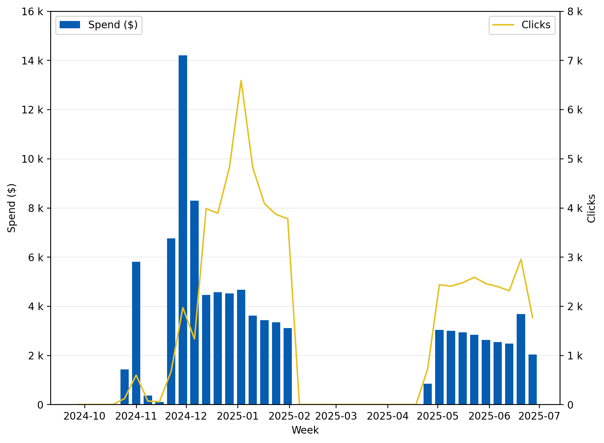
granville spend vs clicks
Media spend on Granville campaigns also has moderate correlation with clicks.
There is a delay in the effects of spend of around 4 to 5 weeks.
The initial spike in clicks is attributed to week where spend was almost $6K ⁽¹⁾ (a soft launch).
This was followed by a week with spend of more than $14K ⁽²⁾ contributing to another spike.
(2)
(1)

Slide 18
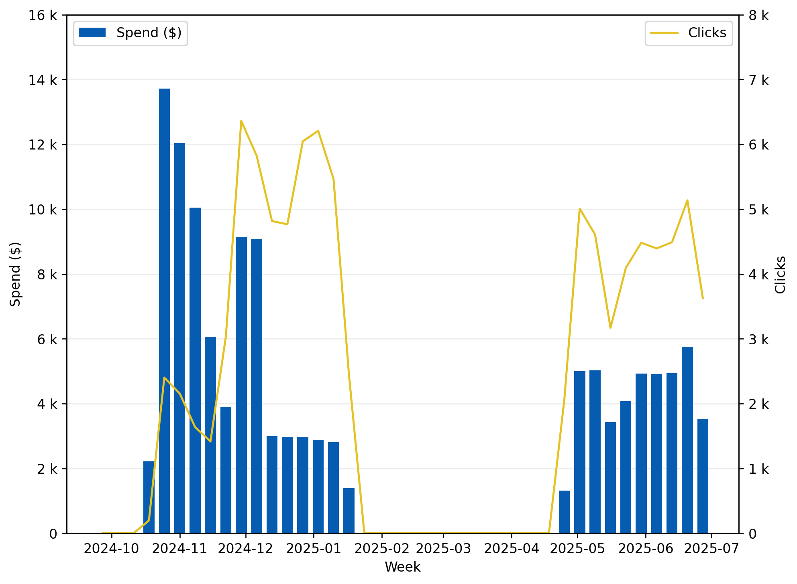
Royalmount spend vs clicks
Media spend on Royalmount campaigns clicks has moderate correlation with clicks.
There is a delay in the effects of spend of around 4 to 5 weeks.
The initial spike in clicks is attributed to week where spend was almost $14K ⁽¹⁾, followed by weeks with spend of almost $10K ⁽²⁾ contributing to another spike.
(1)
(2)

Slide 19
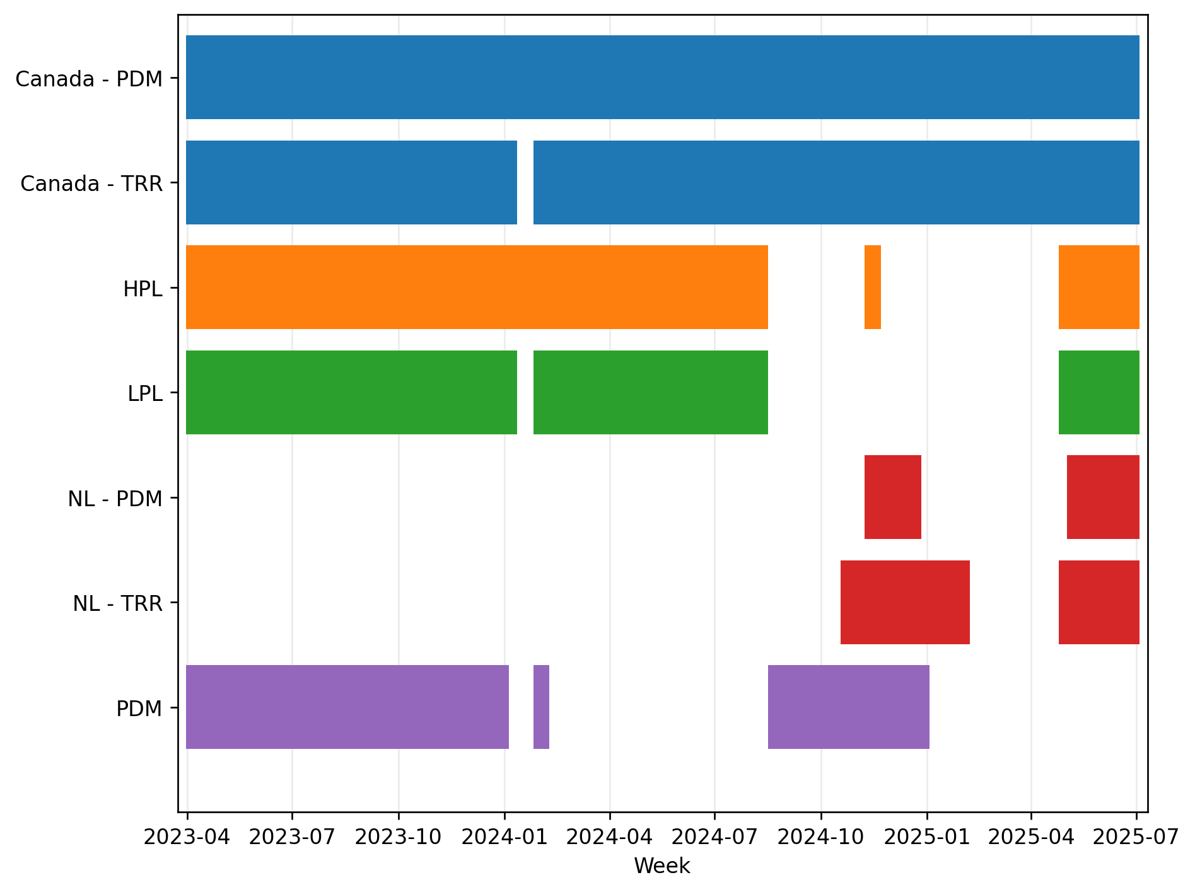
Flighting
HPL = High-performing locations
LPL = Low-performing locations
NL = New locations
TRR = The Rec Room
PDM = Playdium
All location types have some form of Always On campaign, as seen by the continuous bars.
New location campaigns were started in Q4 2024, and have been allocated spend consistently before and shortly after opening
HPL had a campaign run during Q4 2024 in Toronto Roundhouse (Taylor Swift Concert Party)
* Data covers Q2 2023 to Q2 2025
* Data does not consider external factors such as weather, holidays
All Campaigns

Slide 20
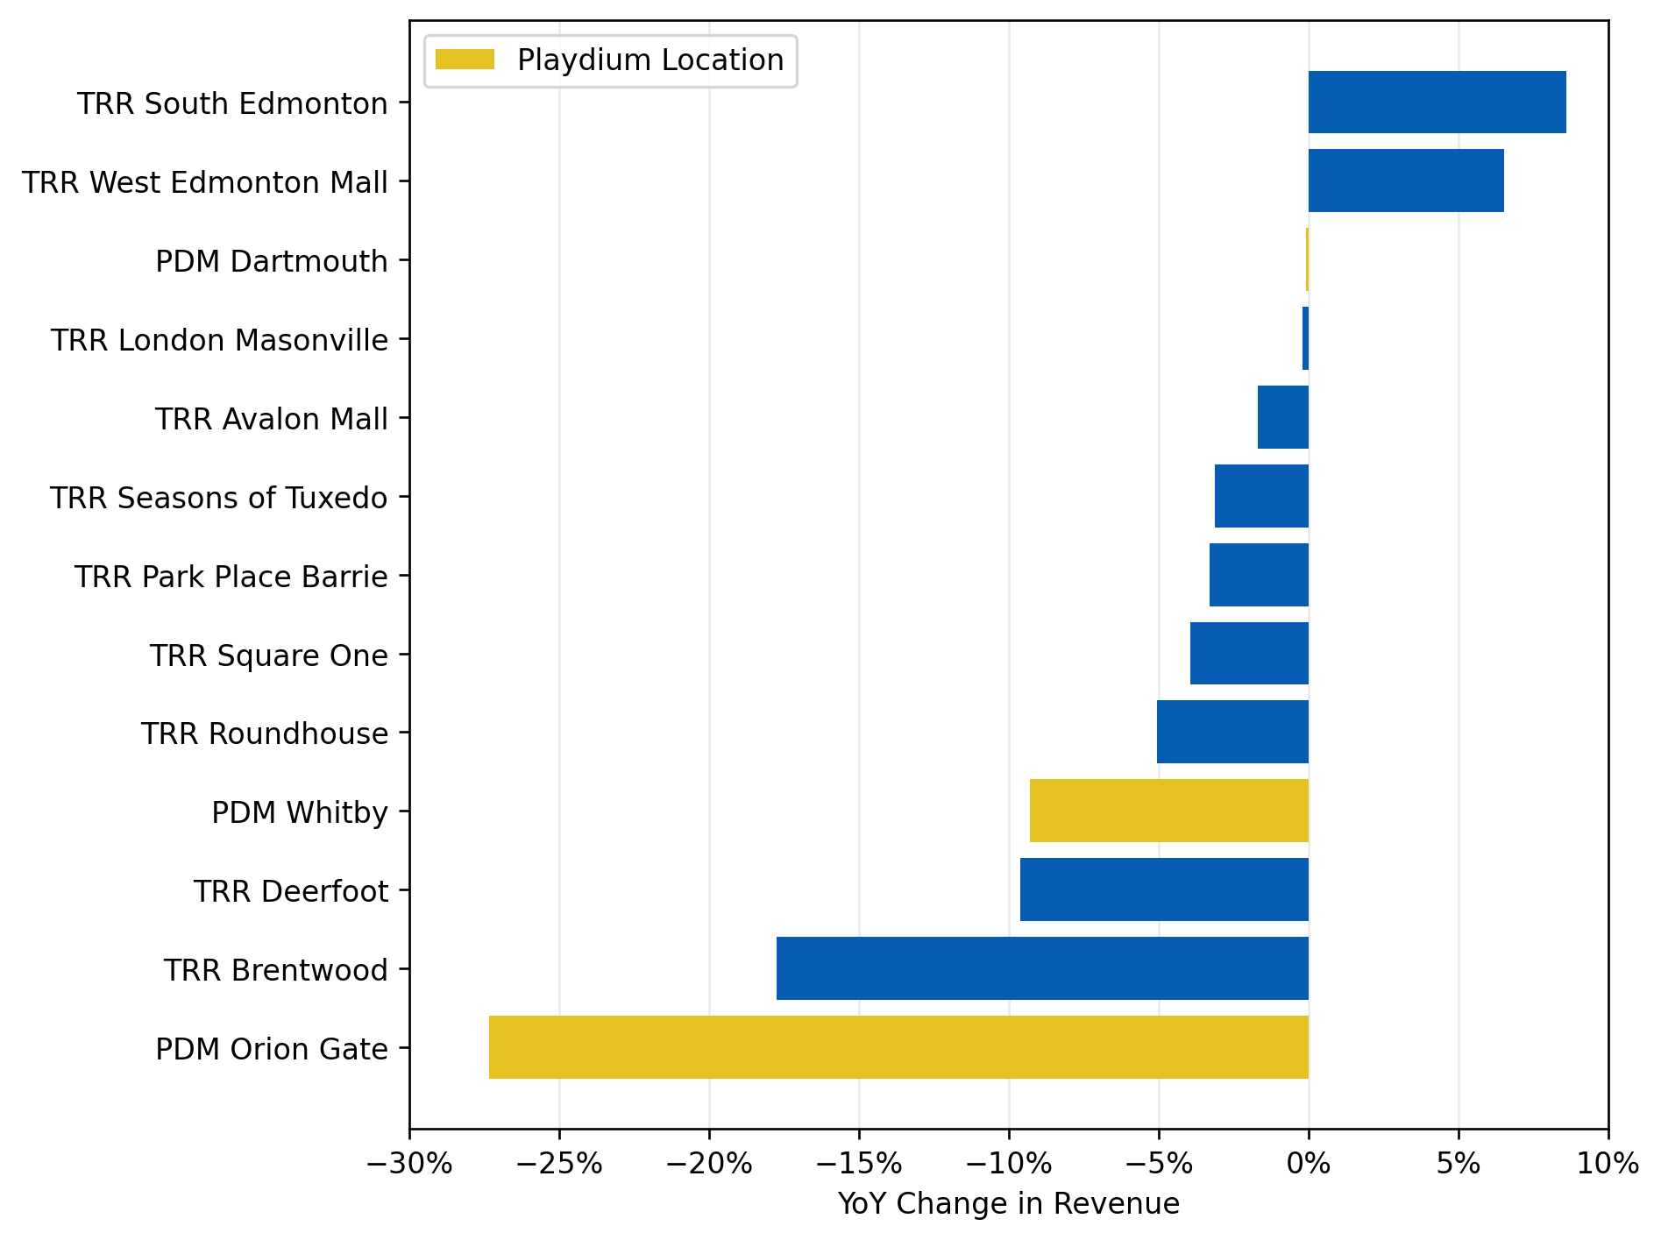
Year-on-year change in revenue by location
Strong positive performance for certain locations
  TRR South Edmonton and TRR West Edmonton Mall stand out with the highest YoY revenue increases.
  PDM Dartmouth and TRR Masonville had almost no change in revenue.
Significant declines in some locations
  TRR Brentwood saw a sharp decline in revenue, with a YoY drop of around 17%. This indicates potential issues at this location that need addressing.
  PDM Orion Gate also shows a significant YoY decrease, suggesting challenges in that location.
*Data covers H1 2024 and H1 2025
*New locations are not included since they were not open for the majority of 2024

Slide 21
Strategic Key Takeaways
Balance Brand vs. Performance Spend:
  Consider if low-conversion periods are better suited for direct response vs. awareness-building.
Optimize Consideration Campaigns:
  Improve efficiency for NL-TRR and NL-PDM in consideration campaigns to match their awareness effectiveness.
Leverage Seasonal Peaks:
  Capitalize on holiday season spikes by aligning increased media spend with seasonal trends for a stronger post-holiday boost.
Strategic Spend Allocation for New Locations:
  Ensure that new location campaigns receive consistent budget allocation and tailored strategies to generate early momentum, as seen in Q4 2024.
Monitor Delayed Effects and Adjust Timelines:
  Incorporate the delayed effects of spend into campaign strategy, especially for Granville and Royalmount locations. Plan campaigns with a 3-4 weeks lead time to better track and optimize the impact.

Slide 22
Channels

Slide 23
Channels summary

Slide 24
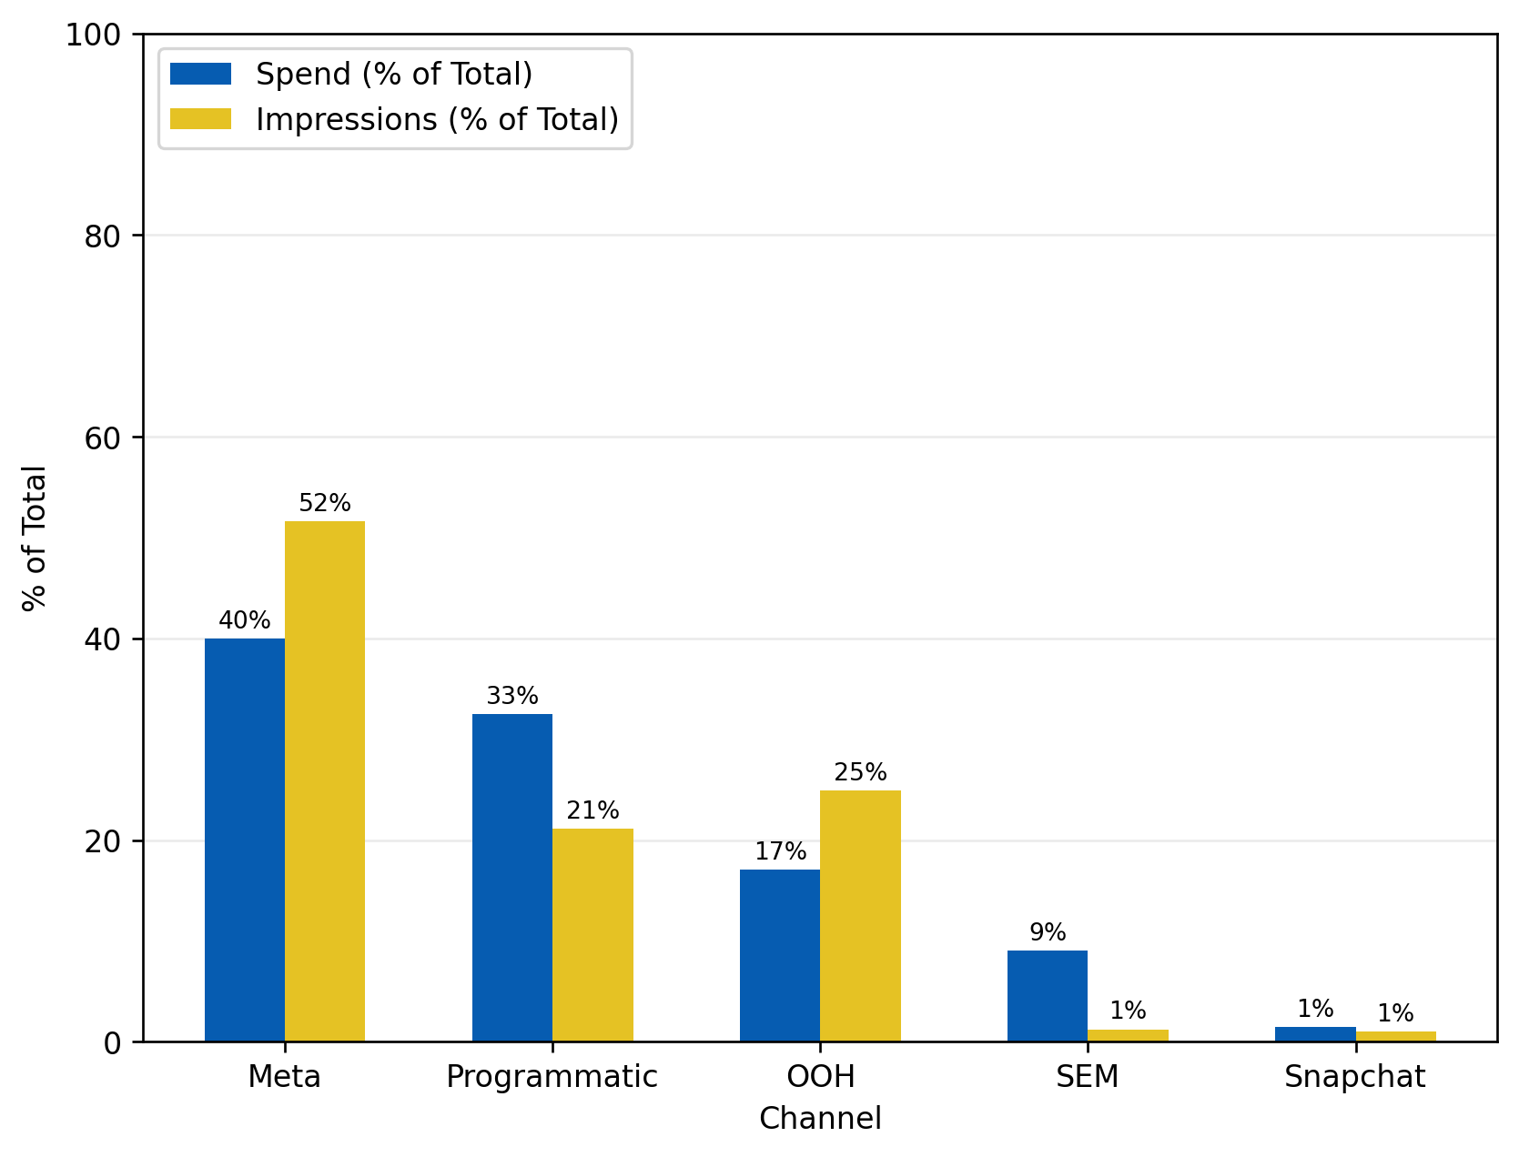
The Rec room Spend by channel vs impressions
Meta had a spend proportion of 40% but brought in 52% of all impressions in TRR campaigns, meaning it was the most efficient channel for awareness.
OOH was another efficient channel.
Programmatic and SEM channels were the least efficient, with the proportion of impressions brought in lesser than budget allocation.
Note:
Snapchat had approximately 1% of the budget allocation, meaning spend was too small to determine efficiency.
*Data covers Q2 2023 to Q2 2025
*Data does not consider external factors such as weather, holidays
Awareness Campaigns

Slide 25
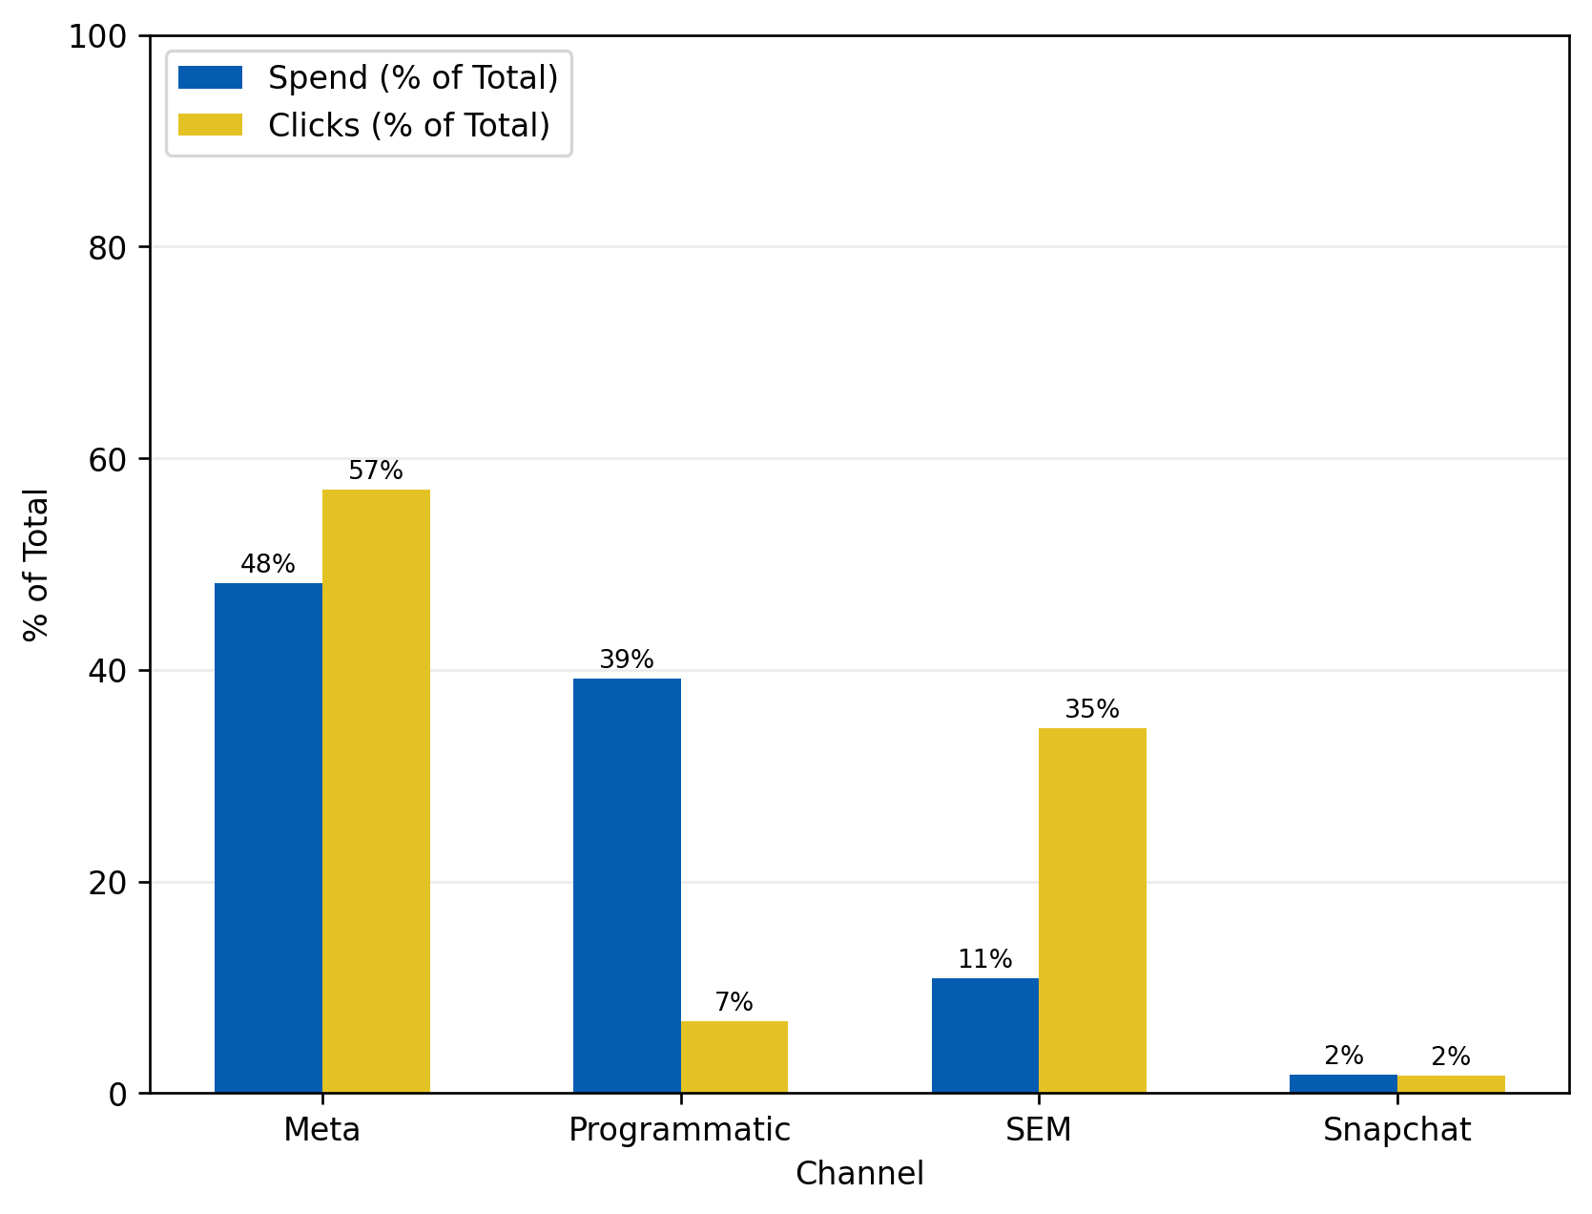
The Rec room Spend by channel vs clicks
SEM had a spend proportion of only 11% but brought in 35% of all clicks, meaning it was the by far the most efficient channel for consideration.
Programmatic was the least efficient, with only 7% of all consideration campaign clicks.
Note:
Snapchat had approximately 2% of the budget allocation, meaning spend was too small to determine efficiency.
*Data covers Q2 2023 to Q2 2025
*Data does not consider external factors such as weather, holidays
Consideration Campaigns

Slide 26
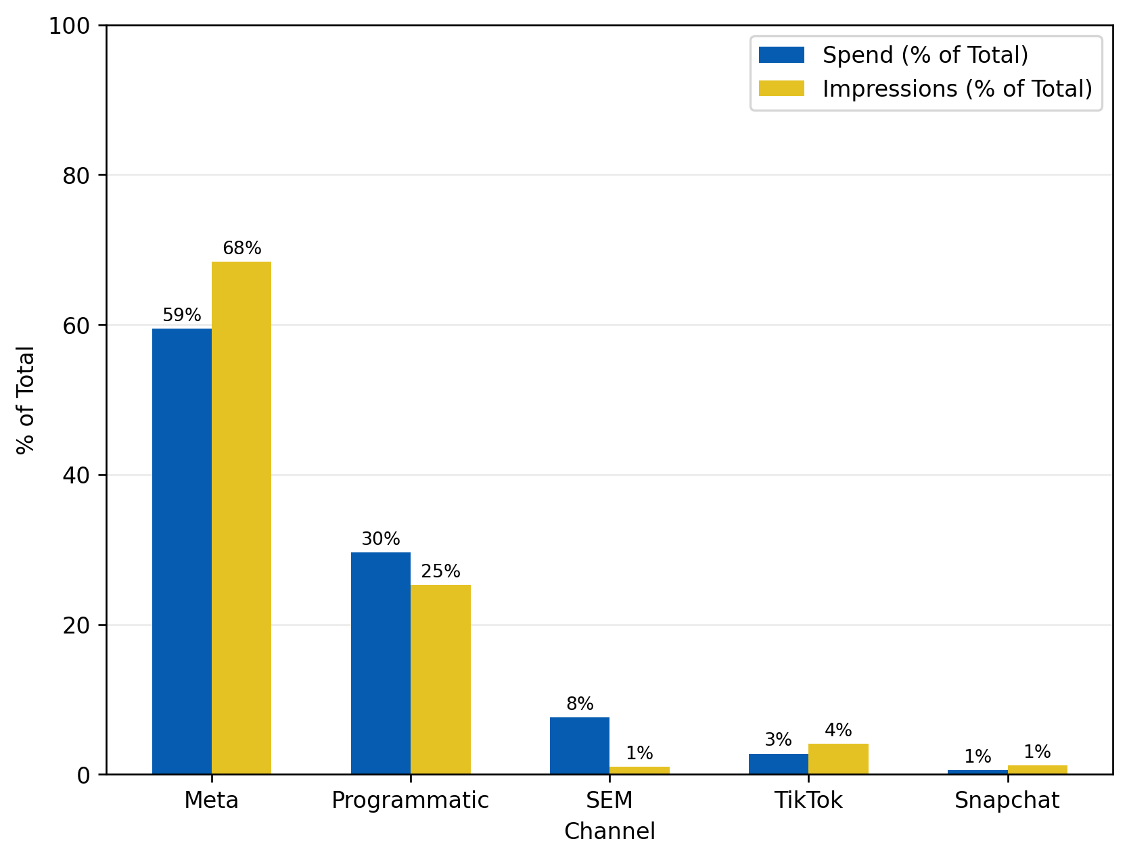
Playdium Spend by channel vs impressions
SEM had a spend proportion of 8% but brought in only 1% of all impressions in PDM campaigns, meaning it was the least efficient channel for awareness.
Programmatic was another channel that was inefficient.
TikTok and Meta channels were the most efficient, with the proportion of impressions brought in at 68% and 4%, respectively.
*Data covers Q2 2023 to Q2 2025
*Data does not consider external factors such as weather, holidays
Awareness Campaigns

Slide 27
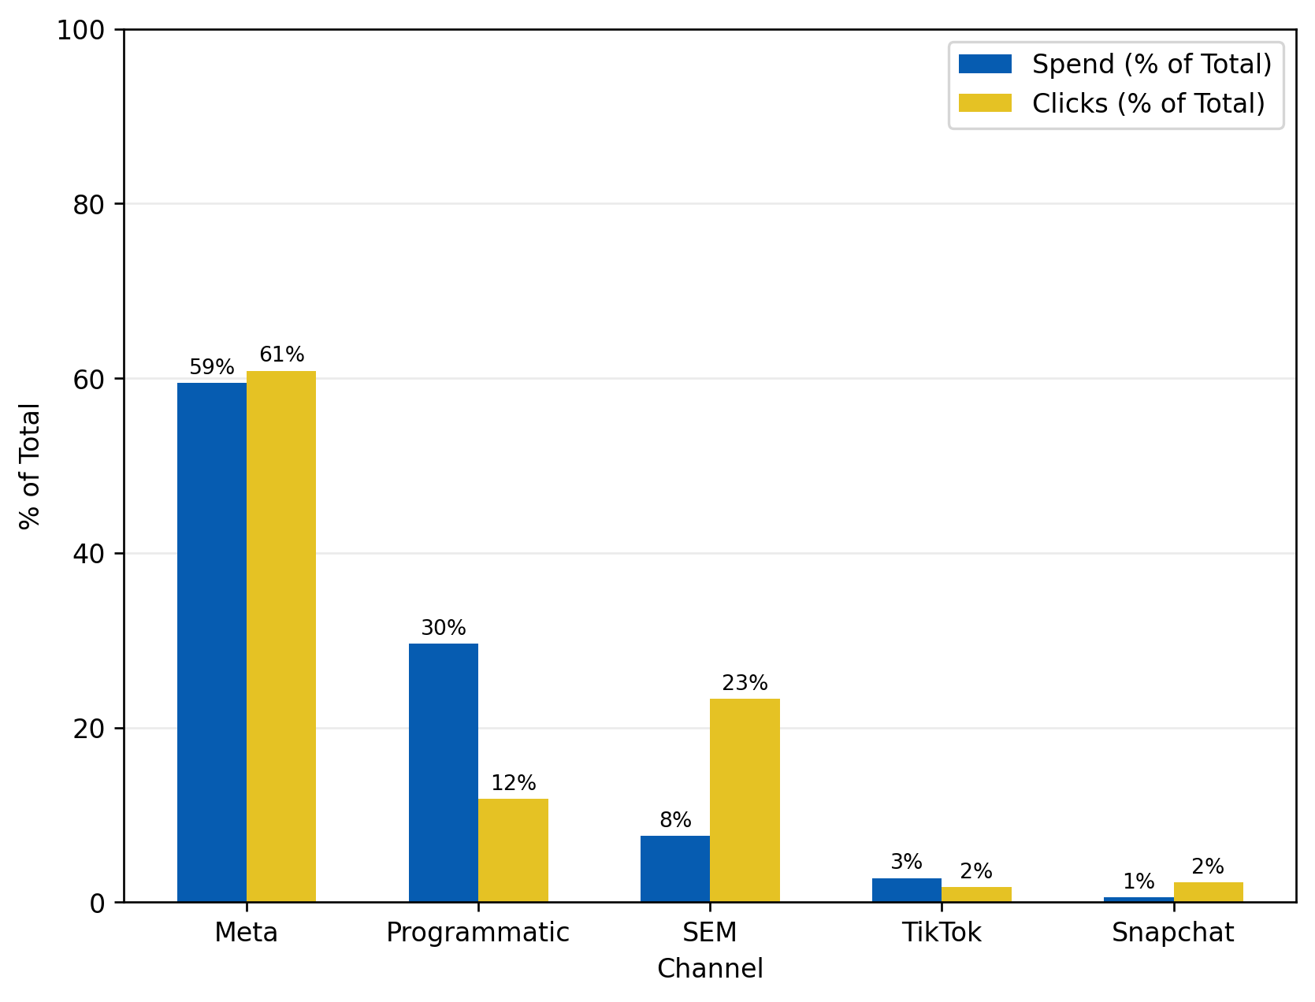
Playdium Spend by channel vs clicks
SEM had a spend proportion of only 8% but brought in 23% of all clicks, meaning it was the most efficient channel for consideration.
Programmatic was the least efficient campaign (like with TRR). It brought in only 12% of all consideration campaign clicks with 30% budget allocation.
*Data covers Q2 2023 to Q2 2025
*Data does not consider external factors such as weather, holidays
Consideration Campaigns

Slide 28
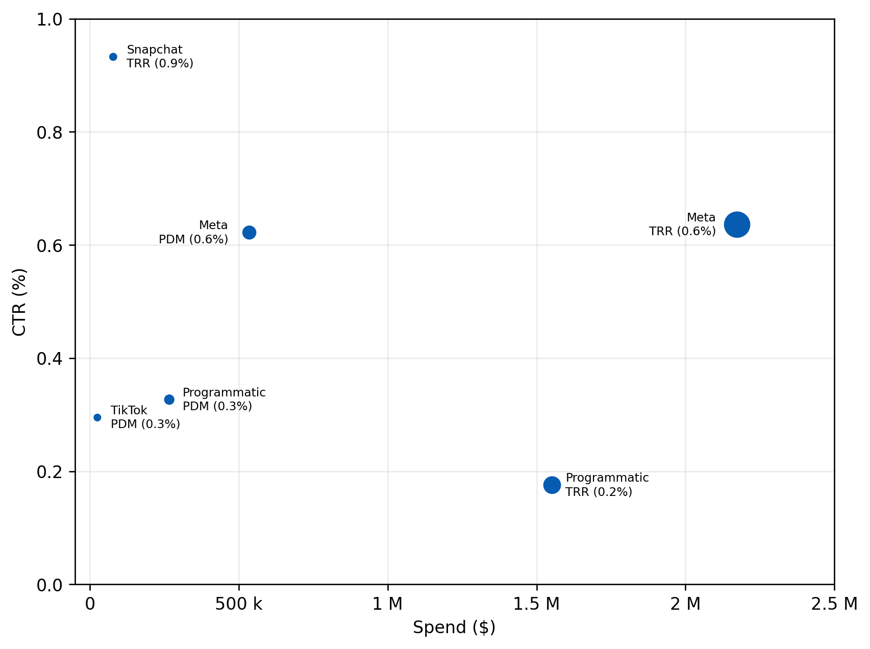
Lbe Spend by channel vs ctr
Programmatic TRR had the second-highest spend at ~$1.2M but the lowest CTR (0.2%)
Meta TRR and PDM have similar click-through rates despite having a difference of ~$1.5M in spend.
Note:
Bubble size = number of impressions
SEM outside chart limits
  Combined TRR and PDM spend of 450k
  CTR of 16.4%
*Data covers Q2 2023 to Q2 2025
*Data does not consider external factors such as weather, holidays
Consideration Campaigns

Slide 29
email

Slide 30
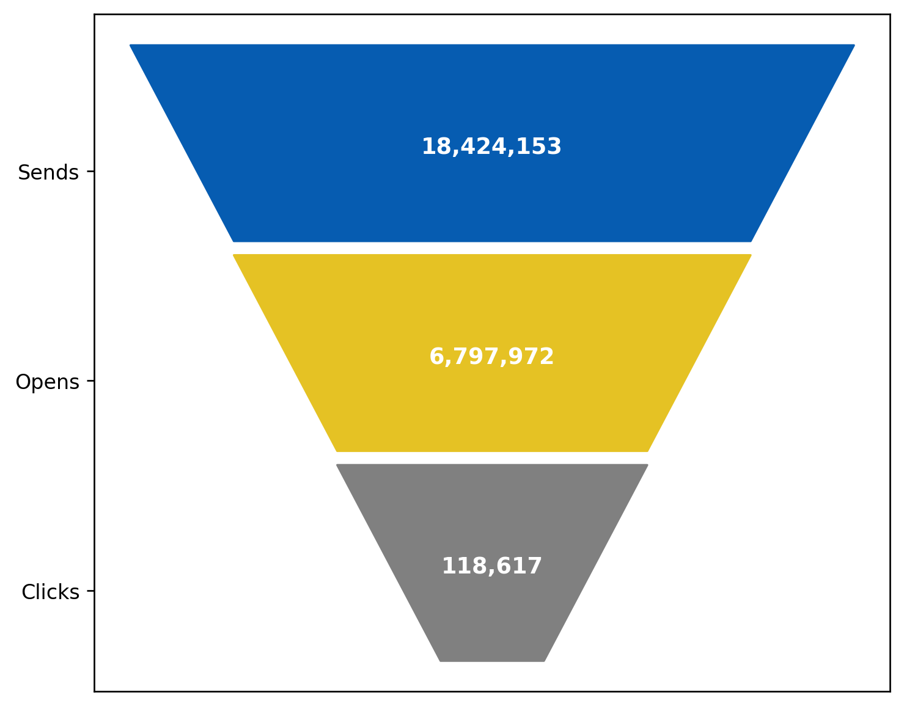
EMAIL USER Journey
Around 37% of emails sent are opened.
Around 1.7% of those opens turn into clicks.
Overall click-to-send rate is around 0.6%.
*Data covers Q2 2023 to Q2 2025
Consideration Campaigns

Slide 31
Channels key takeaways
Reallocate Budget to High-Performing Channels:
  Increase investment in Meta for both awareness and consideration across campaigns, as it consistently delivers high returns. Boost spend on TikTok, especially for awareness campaigns, where it showed high efficiency in bringing in impressions.
Address Underperforming Channels (Programmatic):
  Revisit programmatic strategy – deeper dive into the tactics that work. Optimize between the video vs display tactics.
Improve Low CTR Performance:
  Analyze and optimize Meta's budget allocation for PDM campaigns to achieve better efficiency and higher CTR.
Optimize Spend Proportions and Budget Allocation:
  Increase SEM allocation for consideration while reducing reliance on programmatic for consideration if it continues to underperform.
Continue Monitoring:
  The bubble size (representing impressions) suggests that certain channels like SEM and Meta may be underfunded in relation to their performance.
Notes:
1.Prioritize Meta and TikTok for awareness.
2.Increase SEM's budget for consideration while optimizing the spend on Programmatic.
3.Rebalance spend on LBE campaigns to optimize Meta’s spend and improve CTR.
4.Monitor performance on Snapchat with more targeted testing

Slide 32
Q&A

Slide 33
appendix

Slide 34
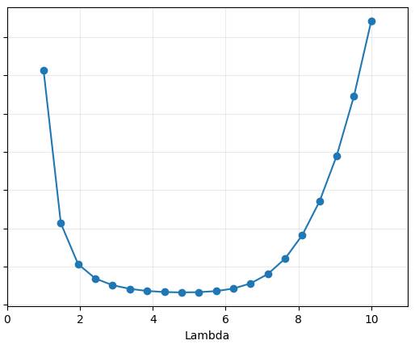
Spend ceiling estimation process
This chart is showing how well the model predicts conversions based on how much we spend on Exhibition. The closer to zero on the vertical axis (y-axis), the better the model’s predictions match real results.
The lowest point on the curve is the best value.
A higher lambda means the model thinks extra spending stops being effective more quickly (we get diminishing returns faster).
In this example, choosing a lambda between 4 and 6 gives us the best results when we assume there’s a limit on how much we can spend.

